Slide 1
SMART INDIA HACKATHON-2020
TEAM NAME : X-SCRAP
PS ID : SG64
MINISTRY : MSME
NODAL CENTRE : IET,AYODHYA
AAKASH SRIVASTAVA(LEADER)
ABHISHEK GUPTA
ABHIJAT MISHRA
AKRITI RAJ SRIVASTAVA
ABHISHEK VERMA
AKASG VERNMA

Slide 2

PROBLEM STATEMENT:
TO DEVELOP A BUSINESS MODEL FOR BETTER UTILISATION OF SINGLE USE PLASTIC AND VARIOUS OTHER INDUSTRIAL WASTE

Slide 3
WHAT’S OUR SOLUTION?
WE HAVE DEVELOPED A MOBILE APPLICATION THAT IS MEANT TO ACT AS A PLATFORM BETWEEN THE WASTE GENERATING /COLLECTING INDUSTRIES OR ORGANIZATIONS AND WASTE CONSUMING INDUSTRIES OR ORGANIZATIONS.
THE SELLER HAS TO LIST THEIR WASTE ITEM (WITH SPECEFIC DETAILS) AND SET A MINIMUM PRICE FOR ITS SALE.
THE BUYERS ALL OVER INDIA HAVE TO REGISTER ON THE APP AND THEY CAN BID ON THE LISTED ITEMS ABOVE THE MINIMUM PRICE.
THE APPLICATION IS:
EASY TO USE
IMPACTFUL ON SOCIETY

Slide 4
WHY THIS SOLUTION?
IN INDIA THERE ARE SEVERAL MSMEs THAT REQUIRE CERTAIN WASTE MATERIAL AS RAW PRODUCTS FOR THAT THEY IMPORT THESE WASTE AND THIS COST THEM HIGH ON RUNNING CAPITAL.
AND THESE SAME WASTE PRODUCTS ARE GENERATED IN INDIA BUT ARE EITHER DUMPED OR LOST JUST BECAUSE OF NO PROPER MANAGEMENT AND DISRUPTED SUPPLY CHAIN.
SO WE THOUGHT OF RE STRUCTURING THE WASTE MANAGEMT STRUCTURE AS THIS APPLICATION WOULD

Slide 5
WHAT DO WE DO?
So what do we do is , we provide a common platform for waste generators and disposers.
We enable management companies and waste producers to bid for the disposal and recycling of waste at the best possible prices.
Whether you are a waste management company , waste producer , individual household , small or large company and trader that generates waste and potentially valuable recyclable waste streams You are welcomed here.

Slide 6
Our current stage:
We have developed the Beta version that is ready to be rolled out.
We have implemented two step authentication so that only geneuine traders could access the app.
1.) OTP validation
2.)Facial recognition using ML
Along with this we have ensured the Quality assurance by our side using cloud based services.
Real time and dynamic bidding is implemented that gives better experience

Slide 7
Current Modules
Authentication
Module
(Backed by :UIDAI )
Waste Listing
Module
Bidding Module
In- App Wallet
Online payment module
Log module

Slide 8
AUTHENTICATION SYSTEM:
NEW USER?
ADHAAR
CARD VERIFICATION
PASSWORD VERIFICATION
FACIAL
RECOGNITION
WITH IMAGE ON
ADHAAR
FACIAL
RECOGNITION
WITH IMAGE ON
ADHAAR
OTP VERIFICATION
SUCCESSFUL LOGIN

Slide 9
WORK F LOW
AFTER LOGIN
bidder
Look for your need
Make your bid
Pay the auction fee
If you win , Pay your bid
Lister
List the details
Set time period
Publish the auction
Choose the winner after time period is over

Slide 10
WHY WOULD ANYONE JOIN US?
FREE LISTING
AND PAY ONLY
WHEN LISTEM ITEM
IS SOLD
EXPOSURE TO MARKET NATIONWIDE
FREE REGISTRATION
FAIL AND ONLINE COMPETITIVE SALE
ADVERTISE TO TARGETED BUYERS USING AI
GURANTED GENUINE TRADERS
ON THE APP

Slide 11
THE REVENUE PLAN?
THERE ARE TWO PLAN OF ACTION TO GENERATE REVENUE:
1.)WE PLAN TO CHARGE AROUND 1% OF EVERY BID FINALISED BY THE SELLER.
THIS IS TO BE CHARGED FROM THE SELLER.
2.)THE BUYER WOULD PAY A FIXED MINIMAL AMOUNT IF IT WINS THE BID.

Slide 12
THE SCALE OF REVENUE
INDIA TODAY GENERATES $92B WORTH EASTE EACH YEAR.
ONLY 11% IS MONETIZED.
INTHE NEXT 5 YEAR:
WE PLAN TO MAKE LEVEL OF MONETIZATION TO 30%
WASTE WORTH AFTER 5 YR=$121B
30% MONETIZATION=$37B
AND WE AIM TO MAKE ALL THIS TRANACTION ON BOARD UPR APPLICATION,
1% FEE ON EACH TRANSACTION GENERATES:=$3.7M
INTHE NEXT 10 YEAR:
WE PLAN TO MAKE LEVEL OF MONETIZATION TO 70%
WASTE WORTH AFTER 10 YR=$260B
70% MONETIZATION=$182B
AND WE AIM TO MAKE ALL THIS TRANACTION ON BOARD THIS APPLICATION,
1% FEE ON EACH TRANSACTION GENERATES:=$1.8B

Slide 13
FOLLOWING SLIDES CONTAIN SOME OF THE SCREENSHOTS OF THE BETA VERSION OF THE APP

Slide 14
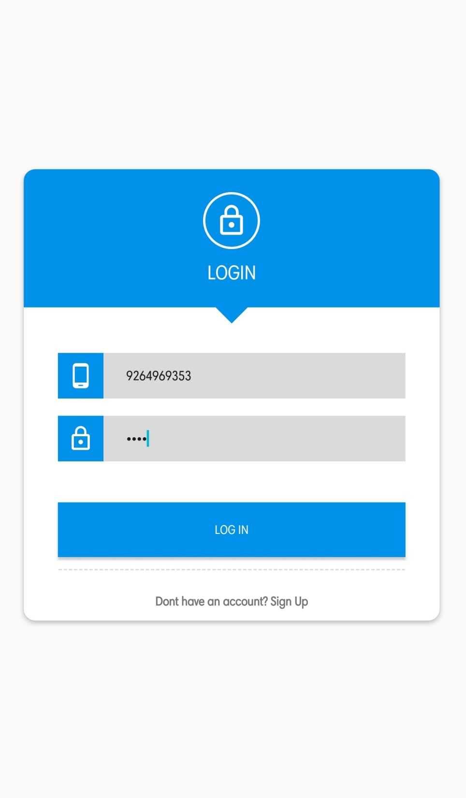

Slide 15
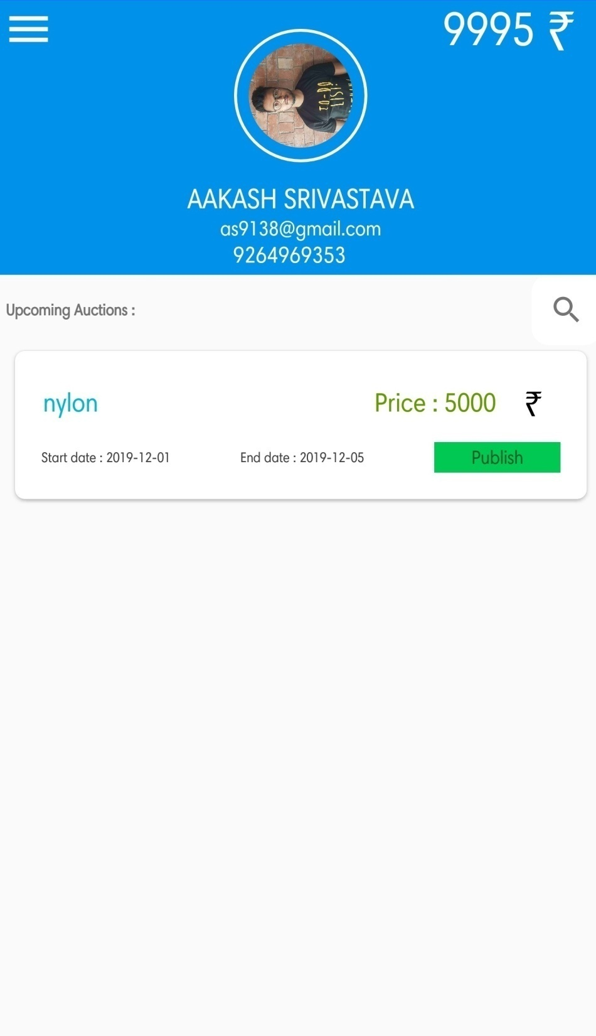

Slide 16
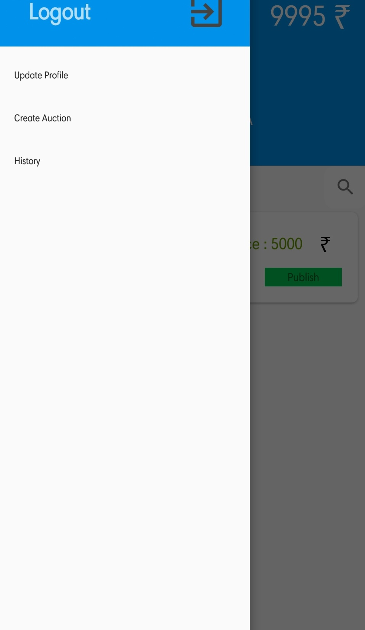

Slide 17
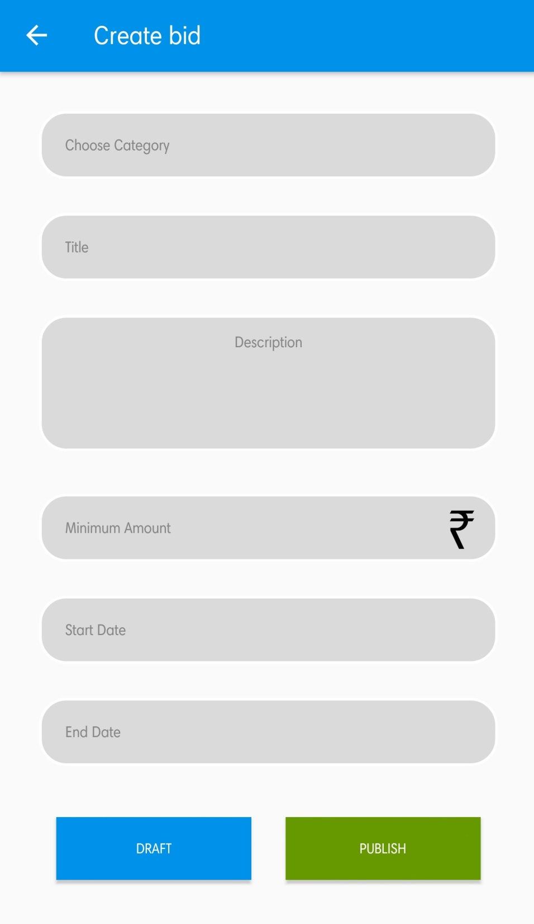

Slide 18
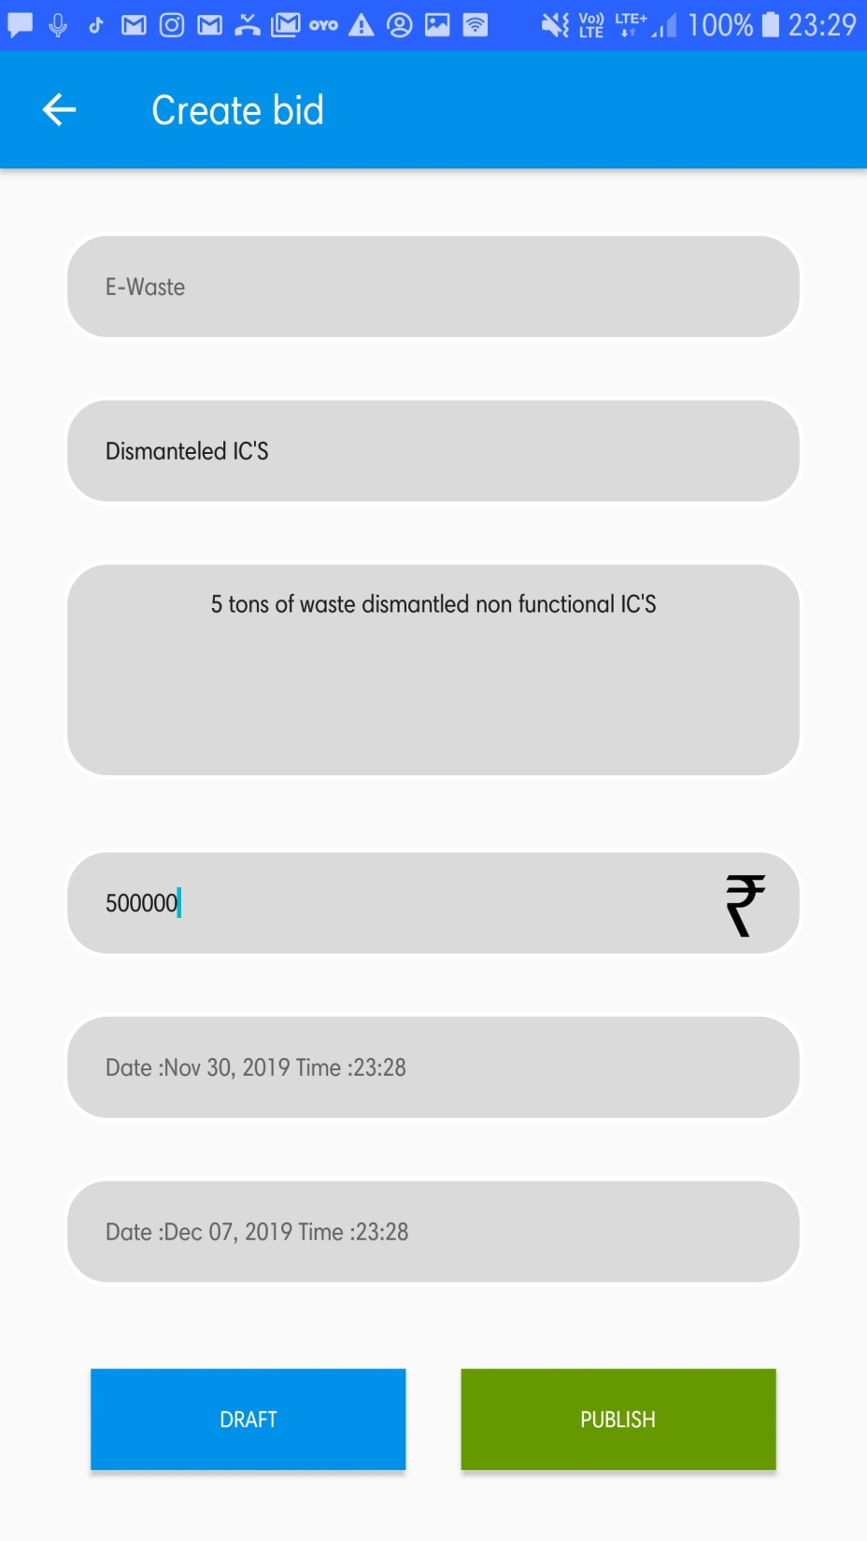

Slide 19
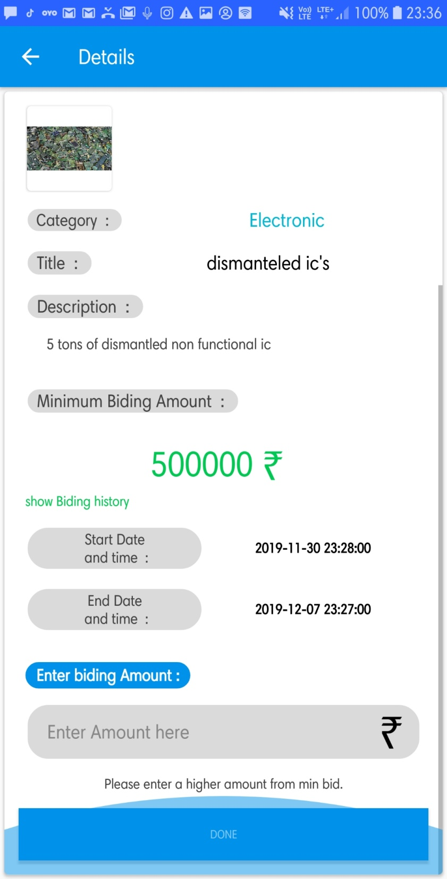

Slide 20
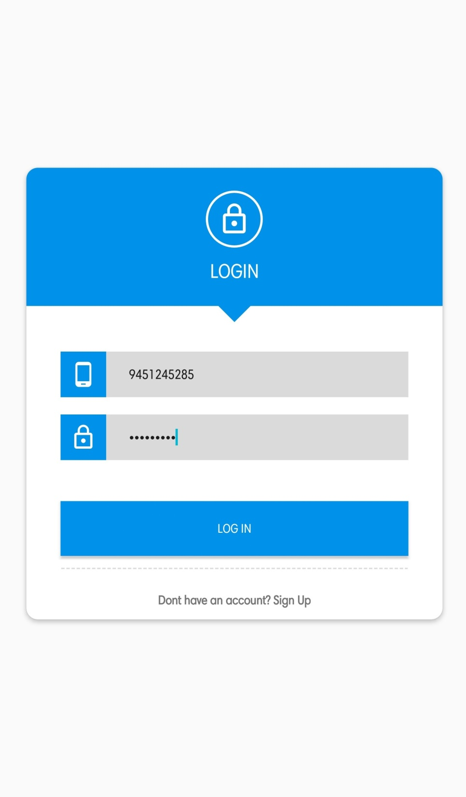

Slide 21
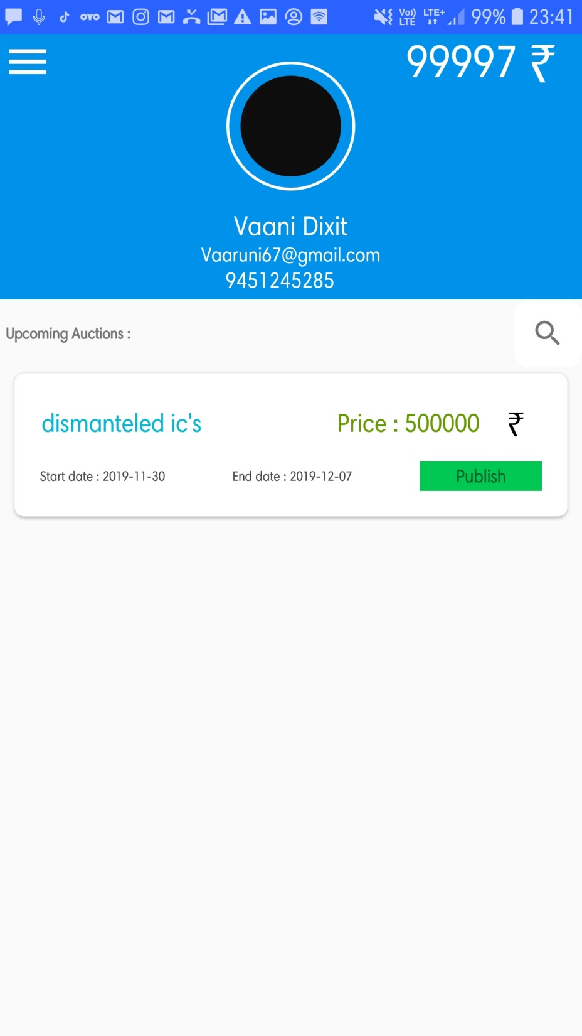

Slide 22
